Slide 1
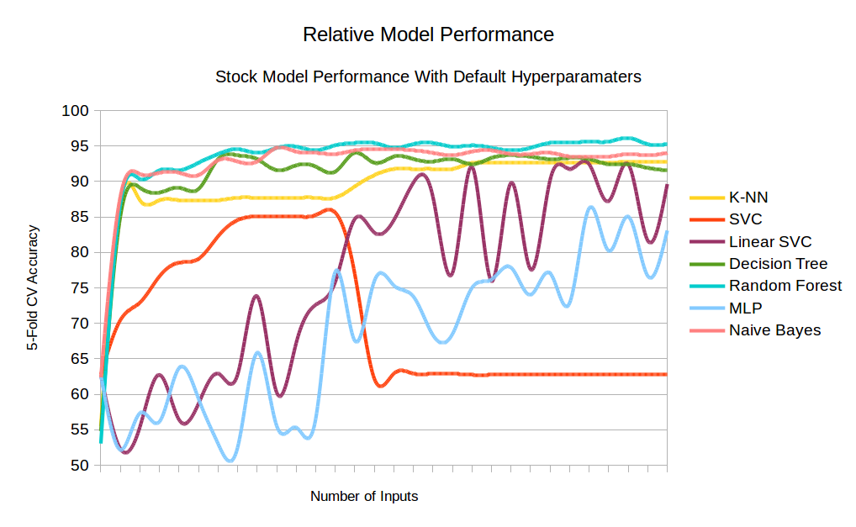

B.R.A.D. Breast-Cancer Risk AnalySis and Diagnostics A machine learning Application to classify breast cancer tumors as benign or malignant
By: TJ Chase, Mike Klein, Pat Iwaszko, & Manmeet Singh
Using Breast Cancer Wisconsin Diagnostic (WBCD) Dataset, we used machine learning to correctly predict breast cancer tumors as benign/malignant to 97% accuracy
Integrated into a JavaScript app to allow easy use by doctors to test their own data for quick, accurate classifications
With a dataset consisting of 500+ inputs, 30 different values and 7 models, found Random Forest on average beat all other models on all inputs

